Slide 1
Effective Management of Mental Health Conditions
Ielhaam Jacobs
Ekurhuleni Psychology Department

Slide 2
What to expect
Assessing Mental Health – Biopsycosocial approach
Common Mental Health Conditions in PHC
Interventions
Common Mental health conditions in children and interventions
Referral for severe mental health conditions

Slide 3
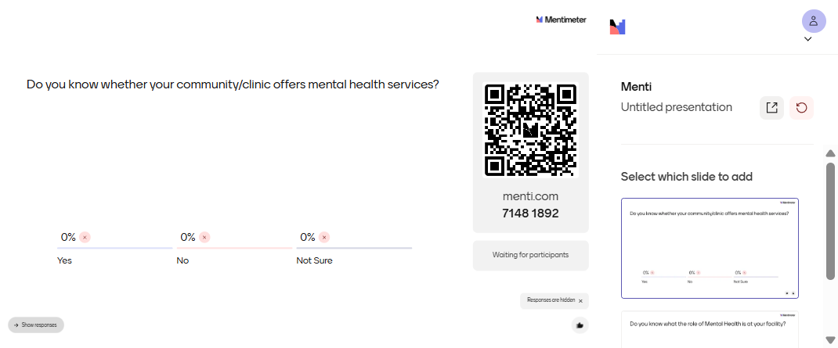
Do you know whether your community/clinic offers mental health services?

Slide 4
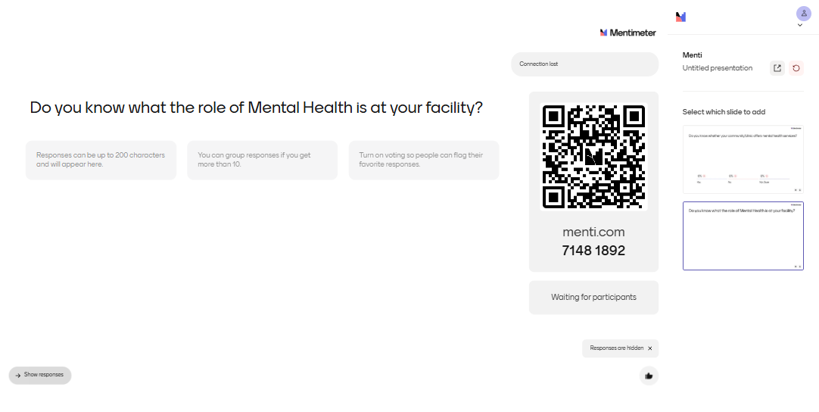
Do you know what the role of Mental Health is at your facility?

Slide 5
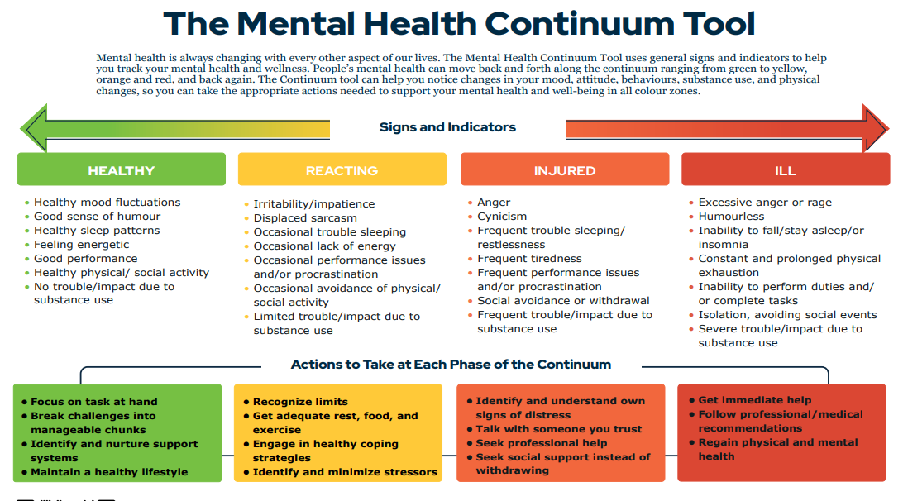
Mental Health Assessment
Promotion → Prevention → Treatment → Rehabilitation
Notes:
Someone with diagnosed mental health condition can have good mental health and vice versa

Slide 6
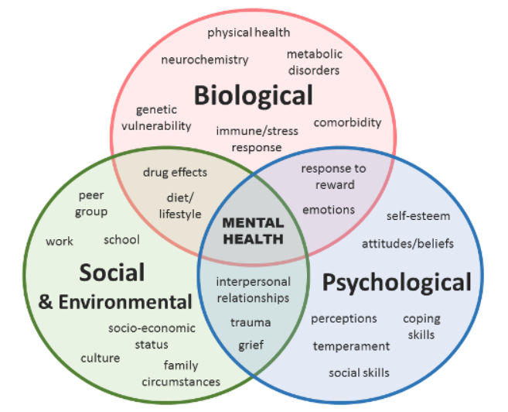
BIOPSYCHOSOCIAL APPROACH TO ASSESSMENT
Mental Health assessments are dynamic & complex
Assessments comprise of patient history/clinical interview, collateral information, screening tools & MSE
Based on assessment, plan interventions/treatment, collaboration with the client is key
Assess for psychiatric emergencies and refer appropriately
Notes:
Social Determinants Impact
Poverty, violence inequality, ACES, increase vulnerability to mental health disorders, often bidirectionally. Addressing social determinants require structural interventions rather than solely relying on biomedical approaches. Social determinants refer to the social and economic conditions that have a direct influence on the prevalence and severity of mental health conditions among females and males across the life course

Slide 7
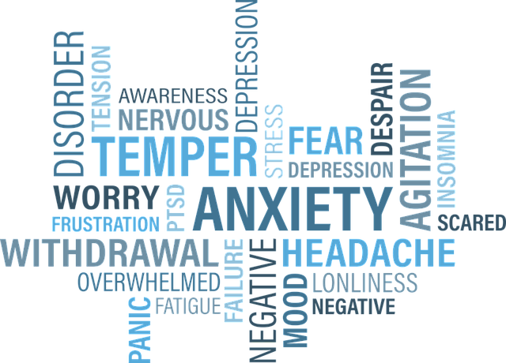
COMMON MENTAL HEALTH CONDITIONS IN PHC
Mood Disorders
Depression features persistent low mood, loss of interest, sleep issues, fatigue, and suicidal thoughts.
Anxiety Disorders
Anxiety involves excessive worry, restlessness, panic attacks, and often coexists with depression.
Trauma-Related Conditions
Trauma causes hyperarousal, intrusive memories, emotional numbing, and functional impairment.
Substance Use Disorders
Substance use disorders, especially alcohol-related, increase morbidity and are linked to violence; Typically requires specialized interventions
Notes:
Who we don’t see: active psychosis/mania, active suicidality. We do not do cognitive/intellectual assessments for DBE.

Slide 8
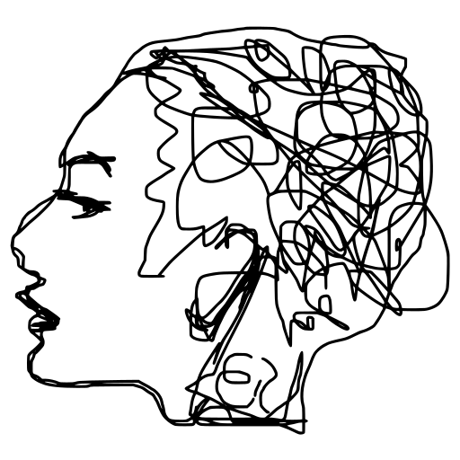
BRIEF EVIDENCE-BASED INTERVENTIONS
Psychoeducation
Psychoeducation helps clients and families understand symptoms, reduce stigma, and set recovery expectations.
Cognitive Behavioural Therapy
Encourages behavioural activation, understanding how thoughts & feelings affect behaviour; Includes homework that allows clients to challenge maladaptive thinking patterns & behaviours
Problem-Solving Therapy
Supports clients to identify problems, generate solutions, and review progress, aiding coping under social stress.
Techniques for Anxiety and Substance Use
Mindfulness practices, grounding, cognitive restructuring, and motivational interviewing reduce anxiety and support change.
Interpersonal Psychotherapy
Focuses on resolving current interpersonal challenges & improving relationships to reduce mental health symptoms
Group Psychotherapy
Notes:
Client’s capacity, therapist training, conceptualization of condition and context will inform type of interventions used

Slide 9
CASE STUDY
A is a 25-year-old female. She is unemployed, HLOE: grade 10, she has three children and is in an abusive relationship with her partner of 6-years.
She has recently discovered that she is HIV-positive. She arrives at the clinic to collect treatment and discloses to the nurse that she feels overwhelmed. She has discovered that her partner has impregnated their neighbour and has lost his job due to his excessive alcohol consumption.
Her 7-year-old son is not performing academically, and his teacher has informed her that he will likely repeat the grade. She feels unable to care for her children’s needs and has started neglecting them.
She feels worthless and worries about her future and her children’s well-being.
She worries about what to feed her children. Her family lives in CT, her relationship with them is strained and she cannot afford to return home. She stopped attending church. She is unable to sleep at night and wishes she could disappear.

Slide 10

WHAT WOULD YOU DO IN A’S CASE

Slide 11

COMMON MENTAL HEALTH CONDITIONS IN CHILDREN & ADOLESCENTS AT PHC
Neurodevelopmental Disorders​
ADHD and ASD affect attention, communication, and social interaction, requiring long-term support and collaboration with families, schools, psychiatrists, OT and other allied health professionals.​
Emotional Disorders​
Anxiety and depression in children cause worries, irritability, withdrawal, and physical symptoms needing recognition and care.​
Behavioural Disorders​
Conduct and oppositional defiant disorders show defiant and aggressive behaviors often linked to emotional and environmental stress.​
Trauma-Related Disorders​
Trauma affects emotional regulation, concentration, and health; sensitive recognition and support are essential in care.

Slide 12

PSYHOLOGICAL APPROACHES FOR WORKING WITH CHILDREN
CBT for Children​
Focuses on identifying, challenging, and reframing distorted thoughts e.g., "I'm going to fail" to "I can do my best" to change emotional responses and actions
Behavioural Interventions​
Behavioural strategies target specific behaviours using positive reinforcement and caregiver involvement.​
Play Therapy​
Play therapy allows young children to express emotions through play, drawing, and storytelling.​
Mindfulness for Kids
Cultivates awareness of present moment, emotions & phycisal sensations without judgement – reduces anxiety, manage stress, emotion regulation & improves focus
Family-Based Interventions​
Family-focused support enhances communication and emotional understanding, improving child mental health outcomes. Caregiver support groups effective in LMICs Fewster & Gurayah, 2015.

Slide 13
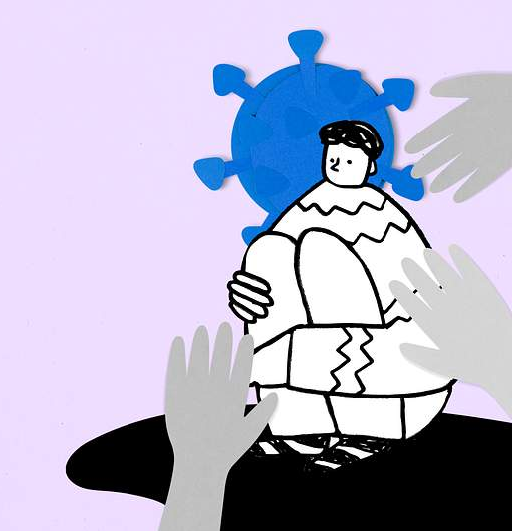
Managing Risk, Psychosis, and Referral Pathways
Stepped Care Approach
Stepped care provide least intensive, most effective mental health interventions in primary care – based on presentation & assessment of the individual’s distress.
Risk Assessment for Psychosis
Assess red flags like hallucinations, delusions and severe agitation for early detection and urgent intervention.
Safety and Legal Framework
Apply Mental Health Care Act guidelines for involuntary care and ensure patient and community safety.
Effective Referral Pathways
Ensure clear communication, family involvement, and follow-up planning for coordinated mental health care.
Notes:
This slide references information from the following file: https://www.gov.za/sites/default/files/gcis_document/201409/a17-02.pdf,https://knowledgehub.health.gov.za/system/files/elibdownloads/2019-07/Policy%2520guideline%2520on%252072-hour%2520assessment%2520of%2520involuntary%2520mental%2520health%2520care%2520users.pdf,https://www.health.gov.za/wp-content/uploads/2024/02/National-Mental-Health-Policy-framework-and-strategic-Plan-2023-2030.pdf,https://knowledgehub.health.gov.za/system/files/elibdownloads/2023-10/APC_2023_Clinical_tool-PRINT.pdf Stepped care is a core principle of mental health service delivery in South African primary care, ensuring that patients receive the least intensive, most effective intervention appropriate to their needs. While most common mental disorders can be managed at PHC level, severe mental illnesses such as psychosis and bipolar disorder require careful risk assessment, early referral, and ongoing collaboration with specialist services. Red flags include hallucinations, delusions, severe agitation, marked behavioural disturbance, and inability to care for oneself. Suicide and violence risk assessment is a critical clinical responsibility. Patients at high risk must not be left alone and require immediate safety measures, including involvement of senior clinicians and urgent referral. The Mental Health Care Act 17 of 2002 provides the legal framework for voluntary, assisted, and involuntary care, including the 72-hour assessment process in designated facilities when involuntary admission is required for protection. Effective referral involves more than issuing a letter; it includes clear documentation, communication with receiving services, involvement of family where appropriate, and planning for continuity of medication and follow-up. Community-based mental health services, NGOs, and social support systems play an essential role in rehabilitation and recovery. By understanding referral pathways and legal processes, PHC healthcare workers can ensure timely, ethical, and coordinated care for patients with severe mental health needs.

Slide 14
Thank you
Thoughts, Comments, Reflections

Slide 15
References
Burns, J. K., Tomita, A. (2015). Traditional and religious healers in the pathway to care for people with mental disorders in Africa: a systematic review and meta-analysis. Social psychiatry and psychiatric epidemiology, 50(6), 867–877.
Lund, C., Stansfeld, S., & Silva, M. D. (2013). Social Determinants of Mental Health. In V. Patel, H. Minas, A. Cohen, & M. Prince (Eds.), Global Mental Health: Principles and Practice (pp. 116-136). Oxford University Press.
Fewster, D. L., & Gurayah, T. (2015). First port of call: facing the parents of autism spectrum disorder. South African Family Practice, 57(1), 31–34. https://doi.org/10.1080/20786190.2014.995917
Mkabile, S., Garrun, K. L., Shelton, M., & Swartz, L. (2021). African families’ and caregivers’ experiences of raising a child with intellectual disability: A narrative synthesis of qualitative studies. African Journal of Disability; Vol 10 (2021)DO - 10.4102/ajod.v10i0.827.
National Department of Health. (2023). National Mental Health Policy Framework and Strategic Plan 2023–2030. National Department of Health.
Petersen, I., Kemp, C. G., Rao, D., Wagenaar, B. H., Sherr, K., Grant, M., Bachmann, M., Barnabas, R. V., Mntambo, N., Gigaba, S., Van Rensburg, A., Luvuno, Z., Amarreh, I., Fairall, L., Hongo, N. N., & Bhana, A. (2021). Implementation and Scale-Up of Integrated Depression Care in South Africa: An Observational Implementation Research Protocol.
Sorsdahl, K., Petersen, I., Myers, B., Zingela, Z., Lund, C., & van der Westhuizen, C. (2023). A reflection of the current status of the mental healthcare system in South Africa. SSM - Mental Health, 4, 100247. https://doi.org/https://doi.org/10.1016/j.ssmmh.2023.100247

